Slide 1


KM YOUTH SOCCER
COACHES’ CLINIC

Slide 2
THANK YOU ON BEHALF OF THE PLAYERS!
2:00-2:05 - Introduction
2:05-2:20 - Technical coaching points
2:20-2:35 - Tactical Coaching points
2:35-2:45 - Coaching methodology / tools kit - Over Coaching
2:45-3:00 - How To Plan My Sessions
3:00-3:30 - Coaching 1-2 Topics - Pre-K Through 3rd Grade (Gym)
3:30-4:00 - Coaching Stage 2 and 3 - 4th Through 6th Grades (Gym)

Slide 3
US Soccer - License Pathway (DCC)
Grassroots
4v4 - N/A
7v7 - April 14, Plymouth, MN
9v9 - April 21, Plymouth, MN
11v11 - April 24, Bloomington / April 22, Detroit Lakes
“D” License
May 18-20 and July 14-15, Chaska, MN

Slide 4
TECHNICAL COACHING POINTS
Dribbling
Passing
Receiving
Shooting
1v1 Attacking
1v1 Defending

Slide 5
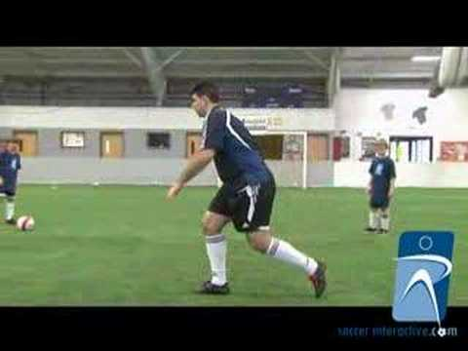

Slide 6
tactical coaching points
U8 - 4v4 (None)
U10 - 7v7 (1-3-2-1)
U12 - 9v9 (1-3-2-3)
U13+ - 11v11 (1-4-3-3)

Slide 7
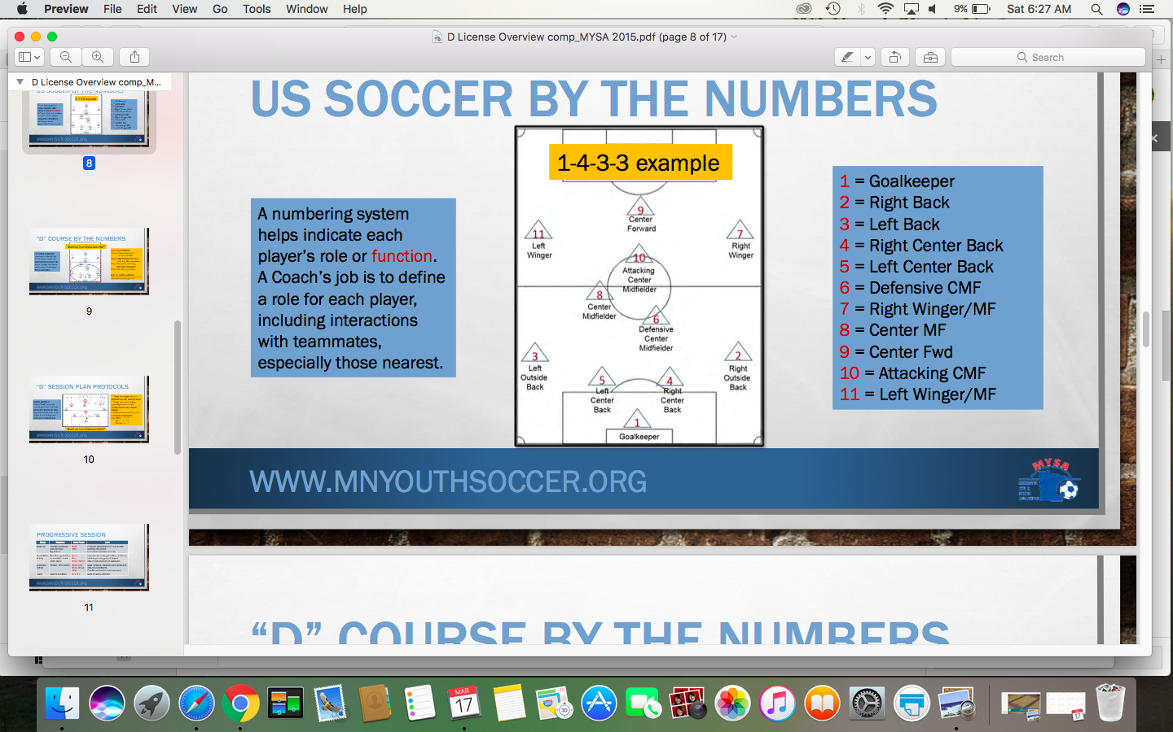
11v11 Formation

Slide 8
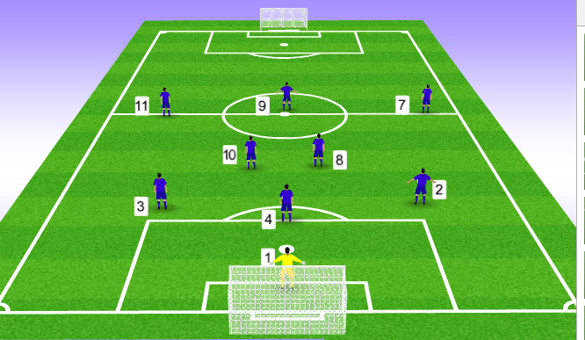
9v9 formation

Slide 9

7v7 formation

Slide 10
coaching pre-k through 2nd grade
Development Focus
How to plan my sessions?
Fun Games

Slide 11
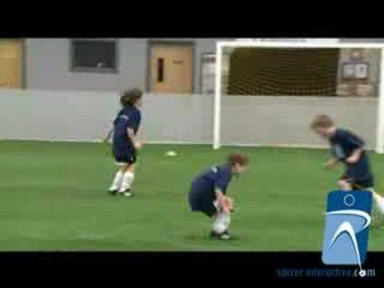

Slide 12
coaching 3rd through 6th grades
Development Focus
How to plan my sessions?
Small Sided Games

Slide 13
Stage 1 - Warm up

Slide 14
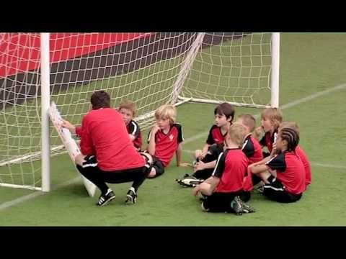
Stage 2 - Orientation

Slide 15
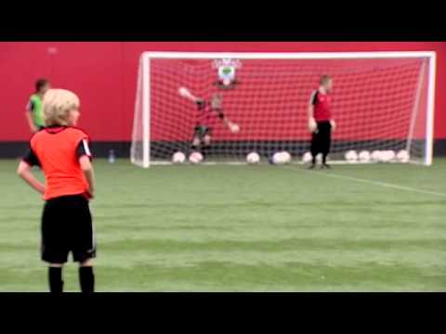
Stage 3 - Learning

Slide 16
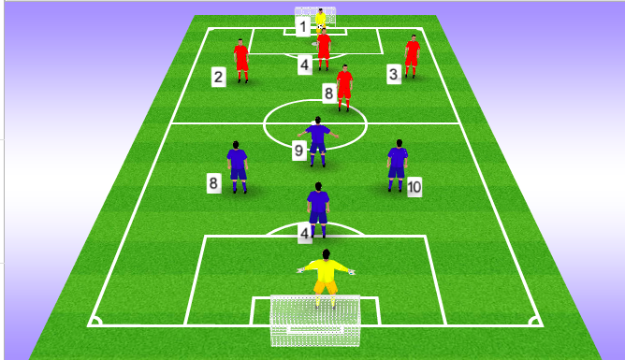
Stage 4 - Game

Slide 17
coaches’ tool kit
Coaching on the flow
Natural stoppages
Freeze Moments

Slide 18
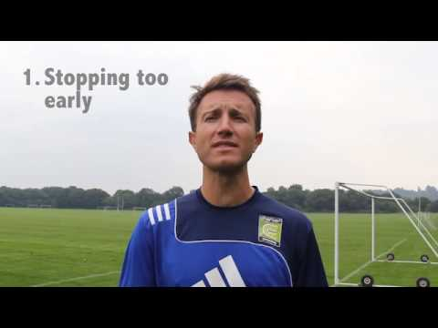
over Coaching

Slide 19
Thank you!!

